Slide 1
Enterprise BI

Slide 2
Introduction
You may have heard the phrase "Data is the new Oil." Digital data is everywhere, and organizations are striving to leverage these large datasets called big data for their competitive advantage.
However, this is no trivial task. In order to achieve this, companies often find themselves investing large amounts of money on software tools as well as introducing cumbersome IT processes.
In this presentation we'll discuss the aspects of data automation and focus on the central goal of extracting the data that is locked in several operational systems, normalizing it to the enterprise's standards and sharing it with the various business stakeholders such as executives, report writers, managers, and data scientists. Furthermore, storing the normalized data on a high performing database platform called a data warehouse for analytics.

Slide 3
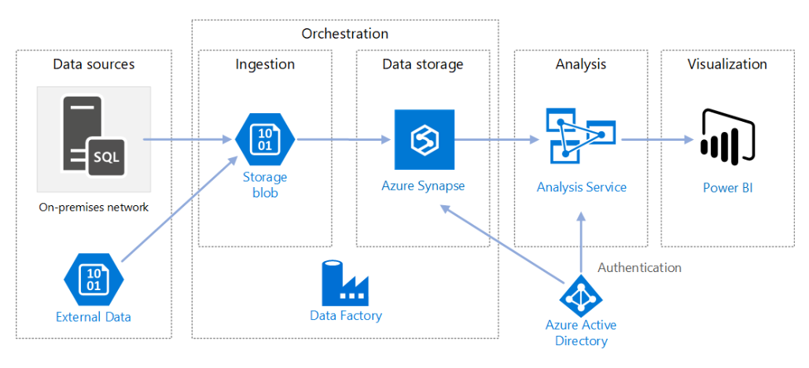
Architecture

Slide 4
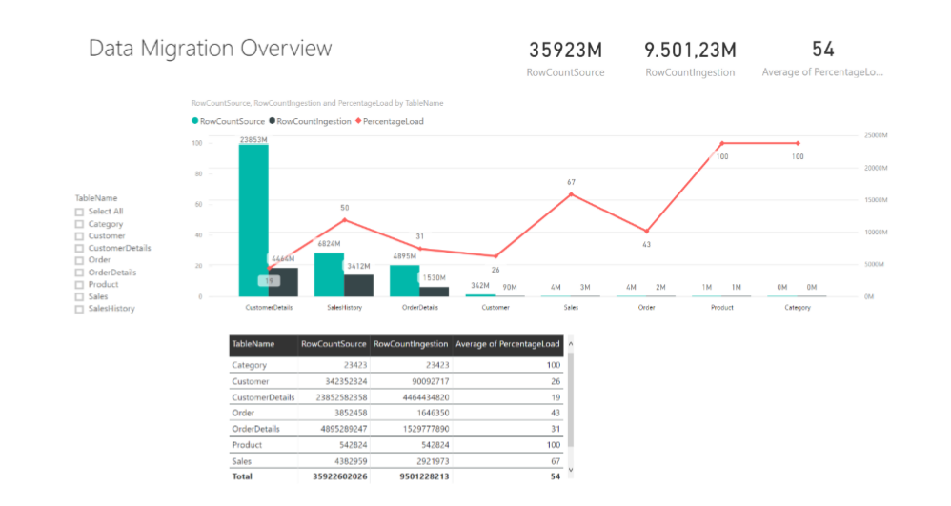
Data Migration Overview

